Slide 1
Book Club Discussion:
All American Boys
by Jason Reynolds & Brendan Kiely

Slide 2
Setting & Audience
This discussion will be held in person at Patrick Beaver Memorial Library located in Hickory, North Carolina; participants can also join remotely via Zoom if they are unable to visit the library
The primary audience is Black youth ages 13-18, but the discussion is open and our doors are open to anyone who wishes to participate
The discussion will take place in our Teen Section where we have plenty of desk space and comfortable furniture; drinks and snacks will also be provided

Slide 3
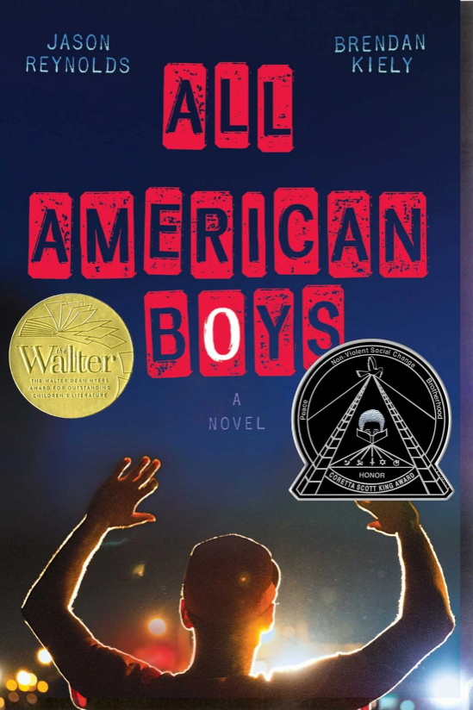
Initial Reactions
Share initial reactions about the book
  What are your opinions about the cover art? Prior to reading, what story does the picture tell?
  How is the title representative of the narrative? Would you change it?
  What are your thoughts on the alternating identities in this story? (Rashad/Quinn & Reynolds/Kiely)

Slide 4
Stand up if…
This is an optional activity. Listen to the following statements and stand/raise your hand if one applies to you. Look around at others standing and sitting to notice something you may have in common.
  …you like to hang out with your friends after school
  …you have kept a secret from someone close to you
  …you have seen or heard news about police brutality
  …you have witnessed or experienced unfair treatment from an officer
  …you have posted something political on social media
  …you have witnessed any act of violence
  …you made a decision in order to avoid disappointing someone

Slide 5
Activity
Write a sample journal entry following the encounter with the white police officer. You may choose one or both:
  POV of Rashad
  POV of Quinn
How does Rashad overcome his challenges? Does he have any role models?

Slide 6
Suggested reading
If you were inspired by All American Boys and you are interested in other related titles, our library has so much to offer. Check out the books below or browse our library catalog here and online:
  You Hear Me: Poems and Writings by Teenage Boys (B. Franco)
  A Graphic Biography of Malcom X (A. Hefler)
  The Hate U Give (A. Thomas)
  Monster (W.D. Myers)
  How it Went Down (K. Magoon)
  Lockdown (W.D. Myers)
  The Bluest Eye (T. Morrison)
  The Black Kids (C. H. Reed)
  Long Way Down (J. Reynolds)
  The Rose That Grew From Concrete (T. Shakur)

